Slide 1
Blueberry Jam
Ingredients:
Organic: Black tea*, black currants, blueberries, elderberri es, cornflower petals, stevia extract. With organic raspberry and natural blueberry flavouring.
Medicinal Properties:
Blueberries treat and prevent digestive orders, improve circulation, maintain eye health, and reduce inflammation.
Elderberry lowers cholesterol, to improve vision, to boost the immune system, to improve heart health and for coughs, colds, flu, bacterial and viral infections and tonsillitis.
Cornflower petals are rich in potassium salts and tannin, a powerful astringent, antiseptic, soothing, and anti-inflammatory properties, help regulate ph levels in the bloodrich in vitamin C, folic acid, and other organic compounds that help detoxify the body.
Black currents help whooping cough in children. And the berry juice is beneficial in colic pains, diarrhea, anemia.

Slide 2
Serenity Now
Ingredients:
Organic: Organic: Currants, rosehips, apple, lavender, spearmint, hibiscus, blueberries, rose petals, strawberries, quince. With natural rose water and strawberry flavouring.
Medicinal Properties:
Rosehip:Diuretic and laxative. The fruit acids and pectin in rose hip tea is a mild diuretic and laxative. It is used to improve, and relieve the symptoms of kidney disorders, or to help in the case of mild constipation.
Apple: antioxidants, flavanoids, and dietary fiber. The phytonutrients and antioxidants in apples may help reduce the risk of developing cancer, hypertension, diabetes, and heart disease.
Black currents help whooping cough in children. And the berry juice is beneficial in colic pains, diarrhea, anemia.

Slide 3
Just Peachy
Ingredients:
Apple, apple pomace (apple pomace, citric acid), sweet blackberry leaves, peach (peach, sugar), natural and artificial flavouring.
Medicinal Properties:
Apples boost your immune system, help reduce the risk of of developing heart disease, diabetes, and even asthma
Blackberry leaves help prevent cholera, anemia, regulates menses, diarrhea and dysentery. Prolonged use of the tea is also beneficial for enteritis, chronic appendicitis, stomach upset, and leukorrhea.
Peaches can be used as a diuretic, expectorant, laxative, and sedative

Slide 4
Strawberry Rhubarb Parfait
Ingredients:
Apple, hibiscus, raisins, carrot, yogurt bits (milk powder, sugar, maltodextrin, modified starch, citric acid), beetroot, strawberry, rhubarb, natural and artificial flavouring.
Medicinal Properties:
Apples boost your immune system, help reduce the risk of of developing heart disease, diabetes, and even asthma
Hibiscus is used to treat colds and improve skin health, including protecting skin from UV rays
Beetroot is a natural detoxicant, antioxidant, diuretic, antipyretic – helping regulate blood presssure.
Rhubarb helps in chronic constipation.diarrhea
inflammation of the colon, liver and gallbladder complaints, hemorrhoids , menstrual complaints ,
poor blood circulation , pain from swelling or inflammation , bacterial infections, and
auto-immune reactions
Strawberry

Slide 5
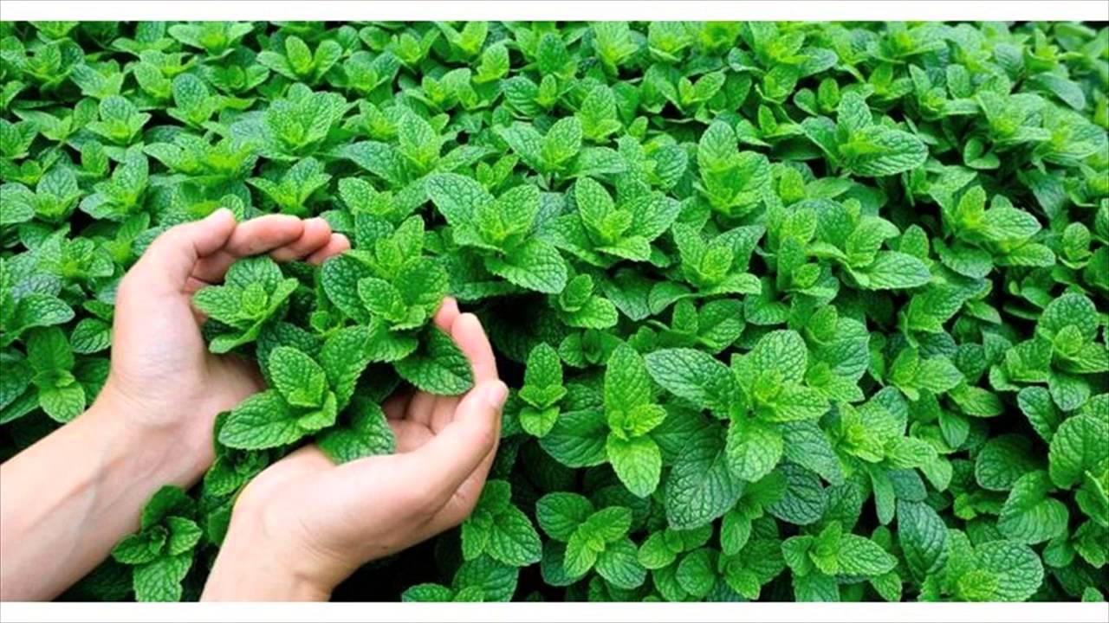
Mint
Ingredients:
Peppermint leaves from Oregon and Washington State.
Medicinal Properties:
Mint has many benefits when consumed as a supplement. It aids the digestive system as it boosts action in the salivary glands, soothes the stomach during bouts of indigestion, and can provide relief for nausea, beneficial in alleviating congestion, stimulant, and aids in better cognitive functioning

Slide 6
White Tea
Ingredients:
Organic: White tea from Fujian province
Medicinal Properties:
White tea is the least processed tea and has the highest antioxidant levels, can thin the blood and improve artery function, reduce cholesterol, and protects the heart and the entire circulatory system.

Slide 7
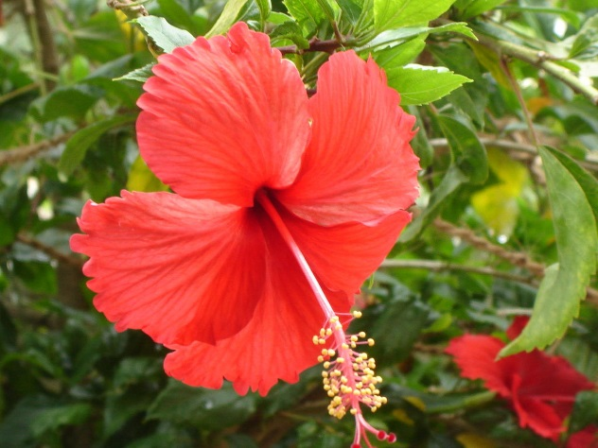
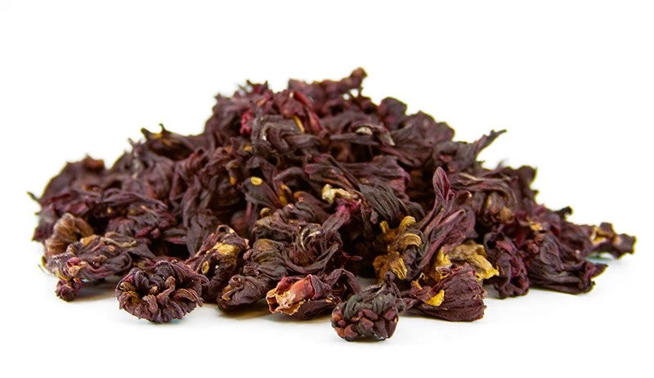
Hibiscus
Ingredients:
Hibiscus flower (dried)
Medicinal Properties:
Hibiscus can provide relief from high blood pressure and high cholesterol, as well as digestive, immune system, and inflammatory problems. It helps to cure liver disease and reduces the risk of cancer. It can also speed up the metabolism and help in healthy, gradual weight loss.

Slide 8
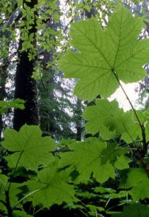
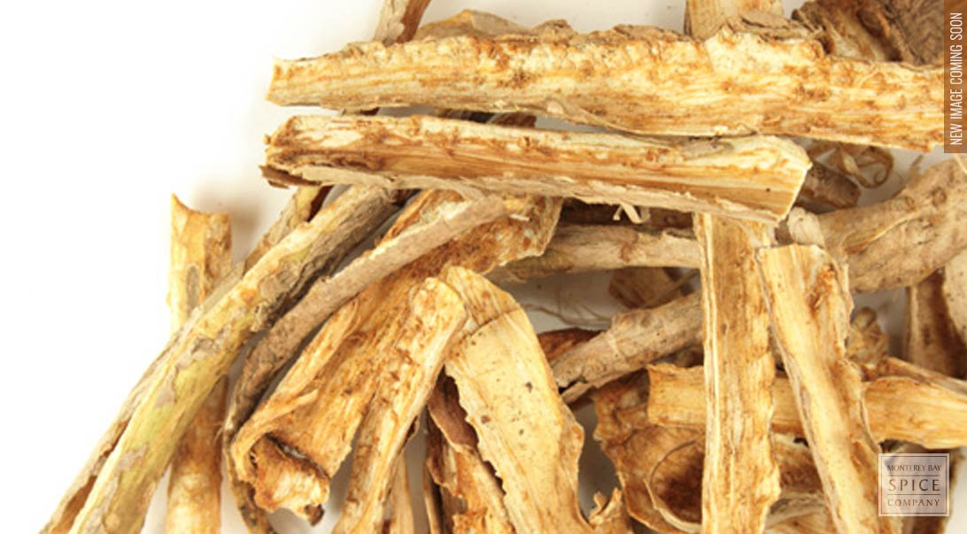
Devil’s Club
Ingredients:
Devil’s club inner bark (dried and prepared)
Medicinal Properties:
Devil’s club extracts of the inner bark appear to have antipyretic, antitussive, and antibacterial properties. The plant has been used internally to treat a variety of conditions including influenza, measles, diabetes, cancer, arthritis, and rheumatism..

Slide 9
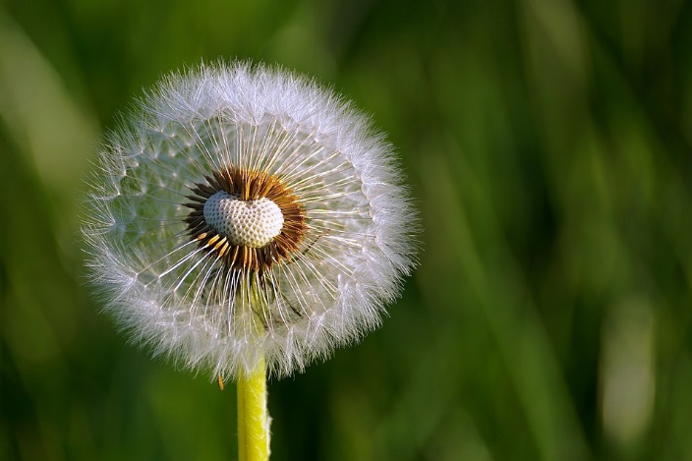
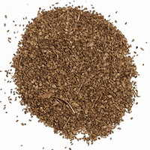
qwáyúwél (halq’emeylem) Dandilion (Root)
Ingredients:
Dandilion root (dried)
Medicinal Properties:
Fresh or dried dandelion herb is also used as a mild appetite stimulant, and to improve upset stomach. The root of the dandelion plant may act as a mild laxative and has been used to improve digestion. Preliminary research suggests that dandelion may help improve liver and gallbladder function.

Slide 10
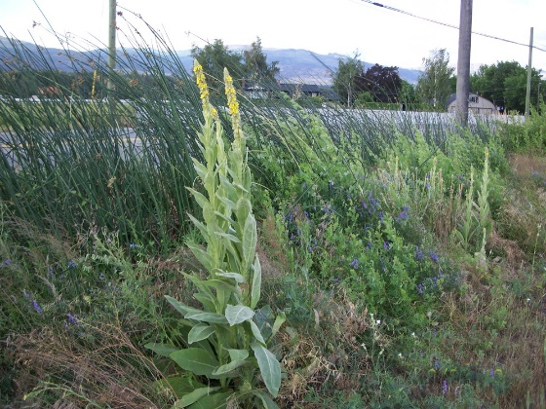
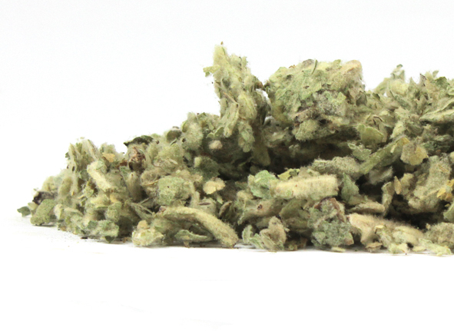
Mullein
Ingredients:
Mullein Leaf (dried)
Medicinal Properties:
The mullein plant has many uses that include the root, leaf, flower, stalk and resin. The mullein leaf is known to support a strong respiratory system and aide in clearing cough and wheezing.

Slide 11
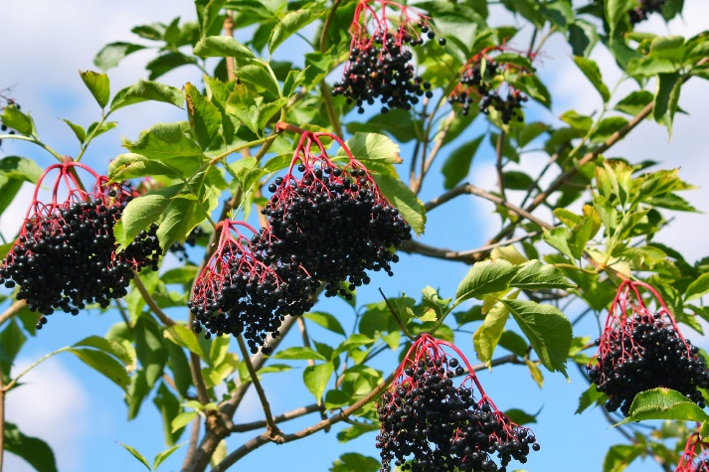
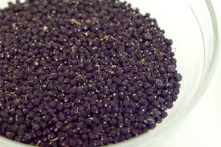
Jitl’l (Haida) Elderberry
Ingredients:
Elderberry berries (dried)
Medicinal Properties:
Used for its antioxidant activity to lower cholesterol, improve vision, boost the immune system, improve heart health and for coughs, colds, flu, bacterial and viral infections and tonsillitis.

Slide 12
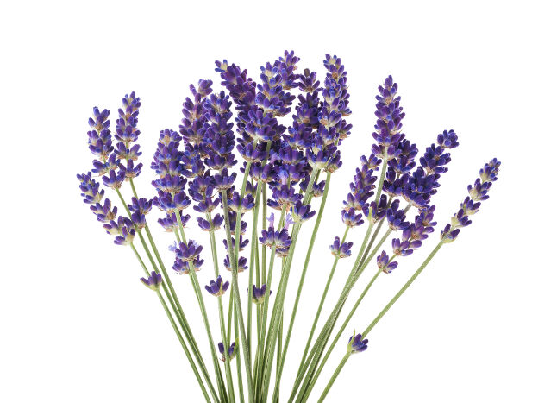
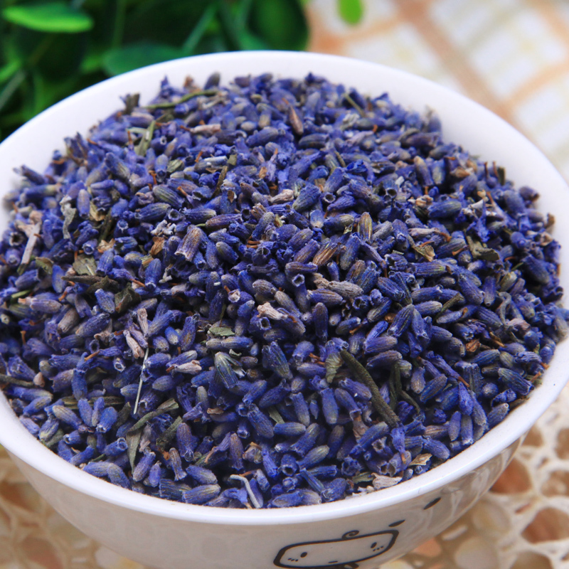
Lavender
Ingredients:
Lavender flower (dried)
Medicinal Properties:
Lavender oil is believed to have antiseptic and anti-inflammatory properties which can be used to help heal minor burns and bug bites. Research has revealed that the essential oil of lavender may be useful for treating anxiety, insomnia, depression, and restlessness.

Slide 13
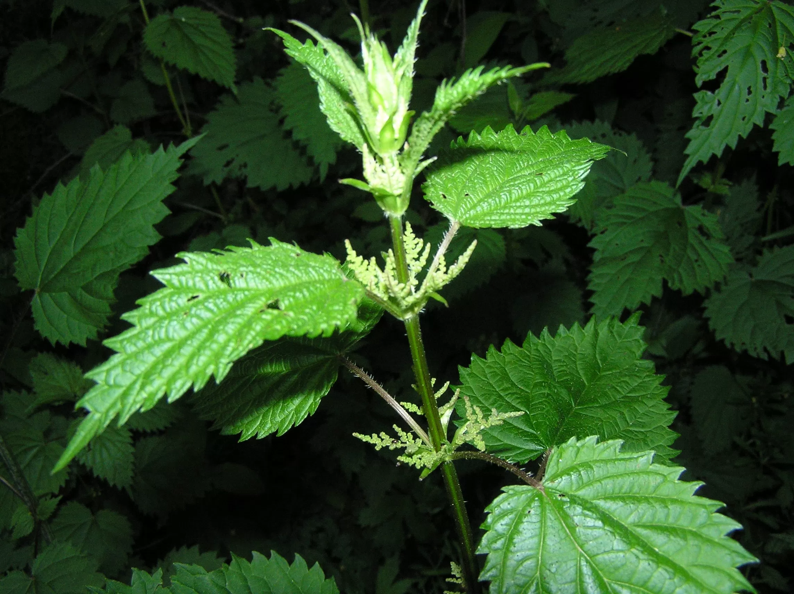
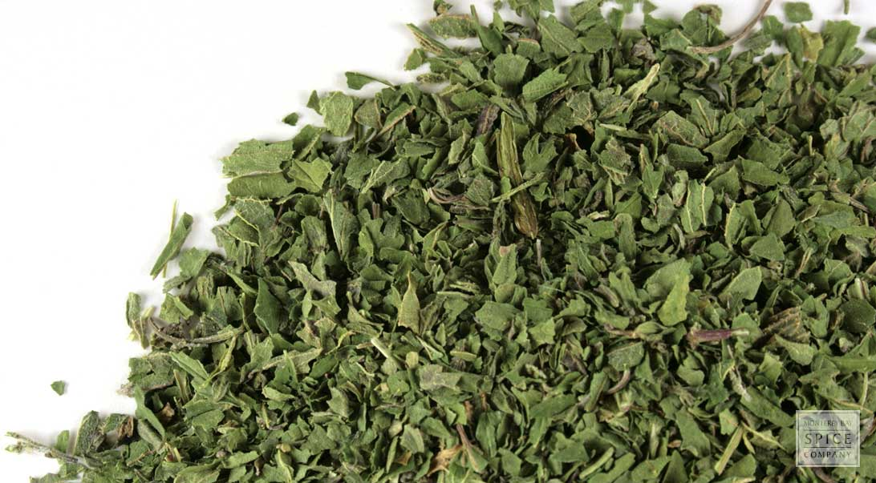
Gudang.xaal (Haida) Nettle
Ingredients:
Nettle leaves (dried)
Medicinal Properties:
Stinging nettle root is used for joint ailments, as a diuretic, and as an astringent. Stinging nettle above ground parts are used along with large amounts of fluids in so-called “irrigation therapy” for urinary tract infections (UTI), urinary tract inflammation, and kidney stones

Slide 14
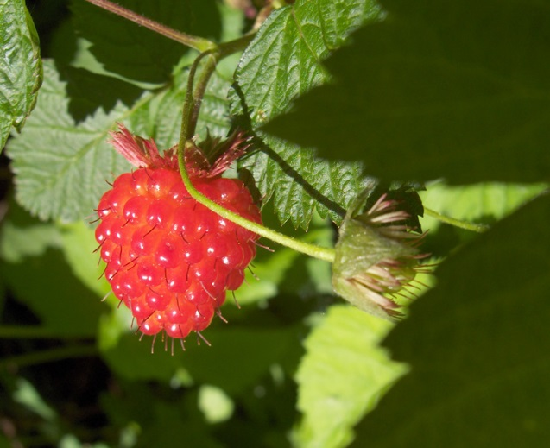
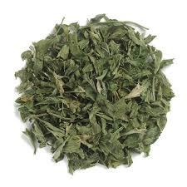
Sk’awgaan (Haida) Raspberry
Ingredients:
Raspberry Leaf (dried)
Medicinal Properties:
Raspberry leaf provides a subtle flavour and acts as a stabilizer for many other ingredients. It is often used as an antioxidant as it is high in magnesium, potassium, iron and b-vitamins. Raspberry leaf is used to treat nausea, leg cramps and to help calm or soothe to aide in sleeping. It can also be used as an ointment to help with skin rashes and sunburn.

Slide 15
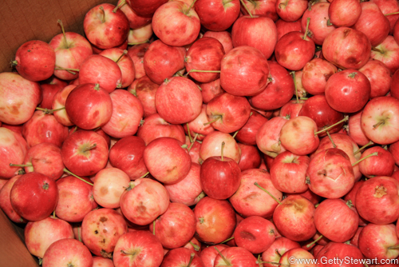
k’aay (Haida) Apple
Ingredients:
Crab apple slices with skin - dried
Medicinal Properties:
Crab apple is a small, bitter apple variety. The fruit pulp is often used as an ointment to heal flesh wounds. The fruit is high in natural pectin and used to help make jams or jellies. The fruit, when dried and eaten can be used as a laxative. It is high in vitamins and acids which promote a neutral digestive system.

Slide 16
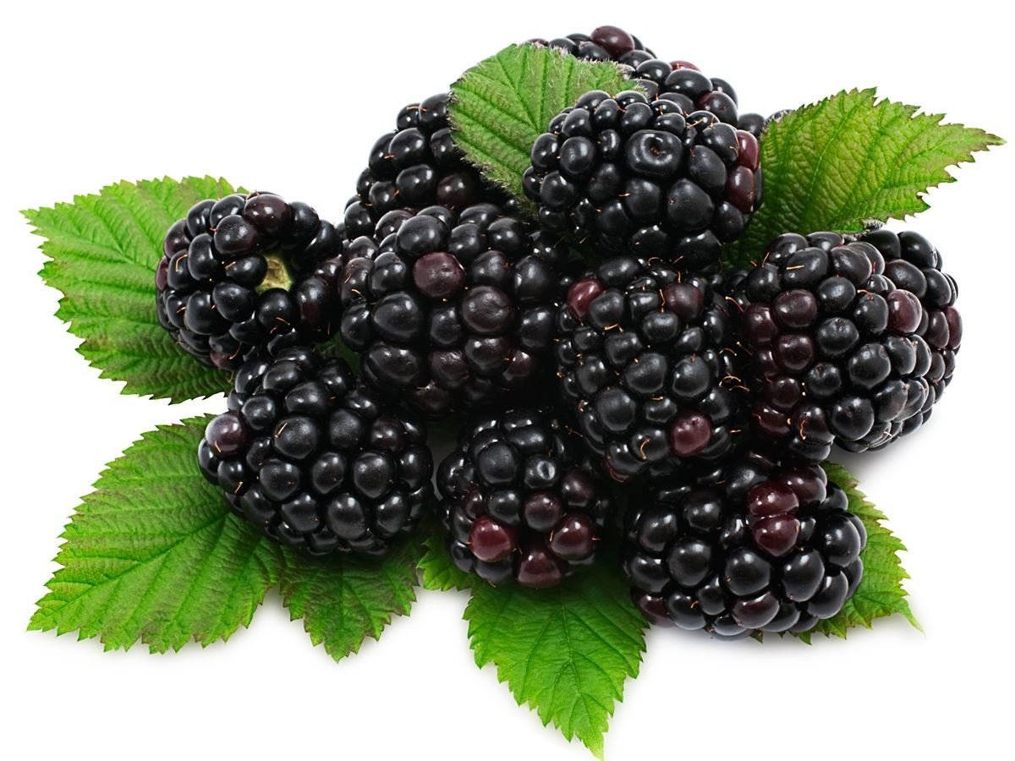
Tllgaa sk’aawgaanga (Haida) Blackberry
Ingredients:
Fresh or dried blackberry fruit
Medicinal Properties:
Used as a natural sweetener, the blackberry fruit is high in antioxidants. The root and leaf can also be dried and used for treating sore throats, cough and digestive discomfort.

Slide 17
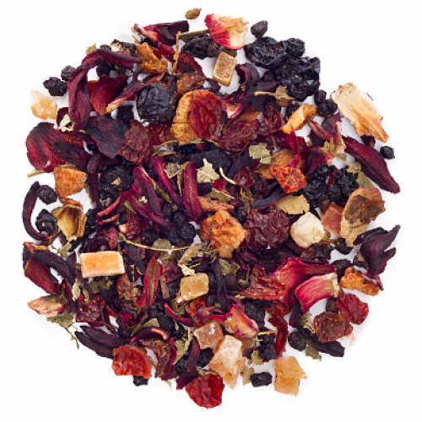
Bear Trap
Ingredients:
Blend of hibiscus, elderberries, rose hip, apple, papaya, lemon, black currents, blueberries, strawberries, raspberries, cherry
Medicinal Properties:
Used as a natural sweetener, the blend of berries provides a soothing tea high in antioxidants and vitamins. It is a good source of digestive and laxative properties that will help keep the blood clean.

Slide 18
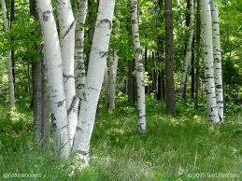
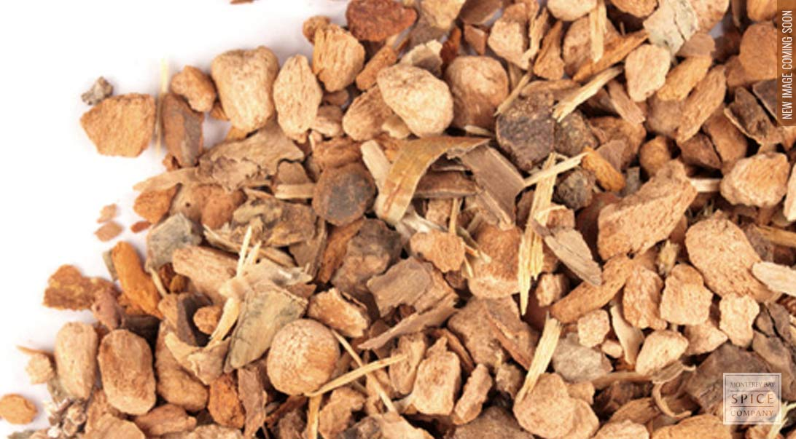
qʷəqʷłin̓ (Sylix) Birch Bark
Ingredients:
Inside bark, peeled and dried
Medicinal Properties:
The birch tree has many uses from the sap to the roots and bard as well as leaves. The bark in a tea helps work as a tonic and detoxifier, working on supporting the health of the urinary system, kidneys, and bladder. It is often used to treat gout, kidney or bladder stones as well as rheumatism. It can be applied as a tonic in tea to reduce swelling and clear skin problems.

Slide 19
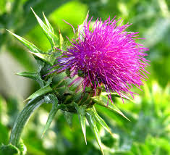
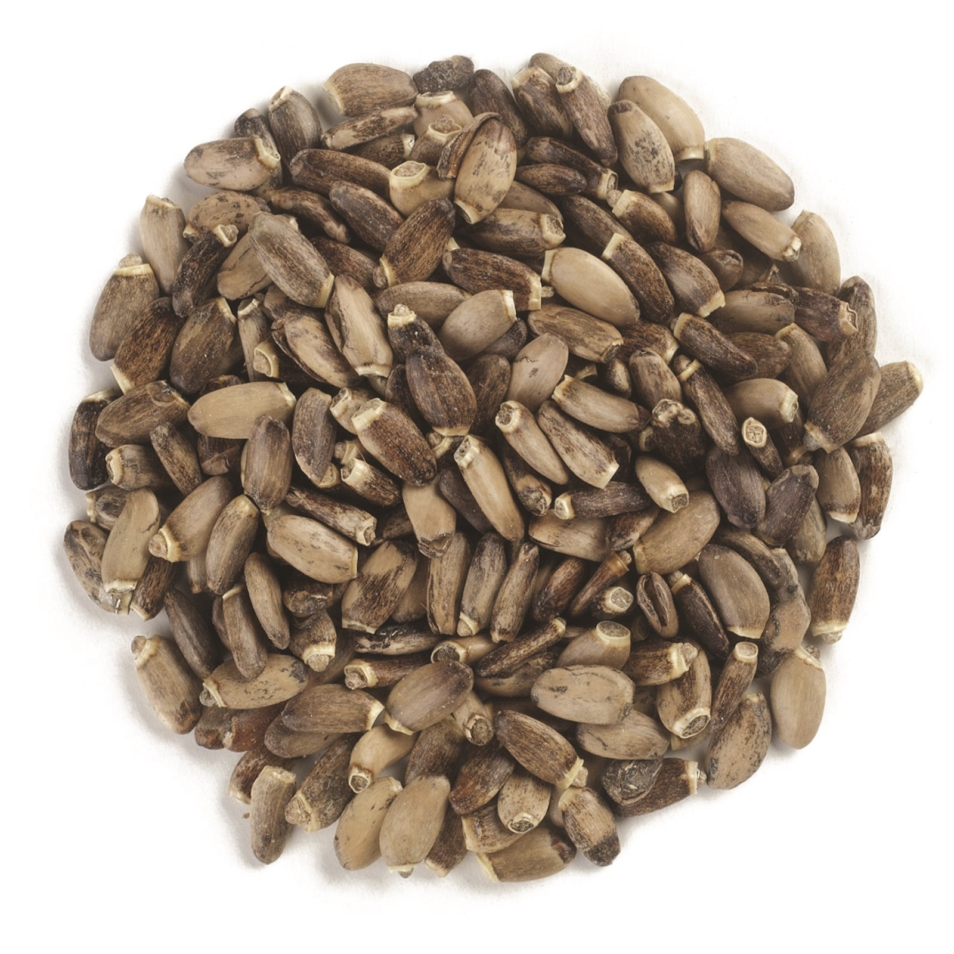
Milk Thistle
Ingredients:
Seed of the milk thistle flower, dried
Medicinal Properties:
Crush the seeds when ready to use – seeds are used to support the liver’s natural detoxification process. It is often given to new mothers to promote milk production. Related to a sunflower the seeds can be eaten but are bitter and lack in flavour.

Slide 20
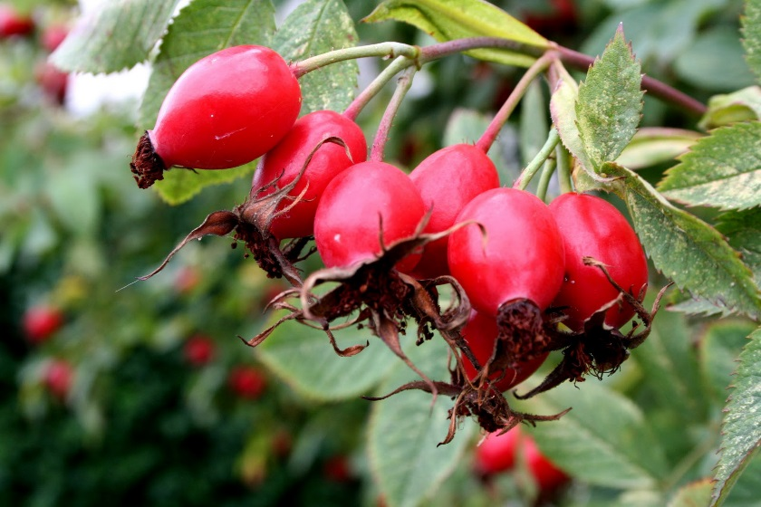
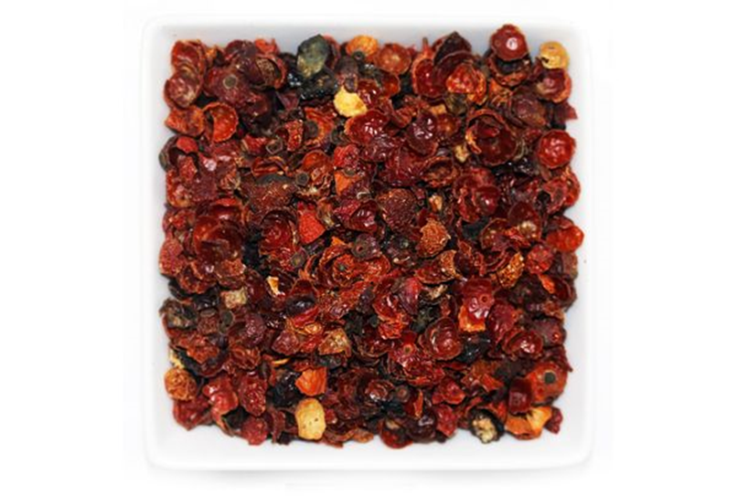
įtsólé (Dene) Rosehip
Ingredients:
Rosehip flowers
Seeds removed
Medicinal Properties:
Rosehips are rich in vitamin C, in fact- it is one of the most potent plant sources of vitamin C, and studies show they contain 50% more vitamin C than oranges! This high vitamin C content make Rosehip tea an excellent immune system booster, often used as a natural supplement to prevent or treat a cold.
The fruit acids and pectin present in Rosehip tea is used as a mild diuretic and laxative. It is beneficial to improve, and relieve the symptoms of kidney disorders, and helps in cases of mild constipation.

Slide 21
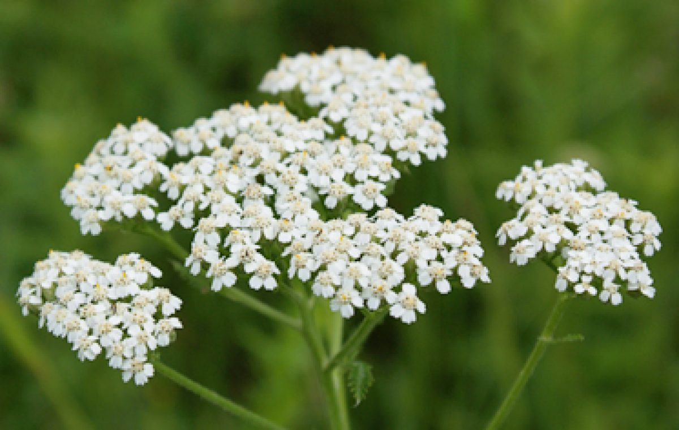
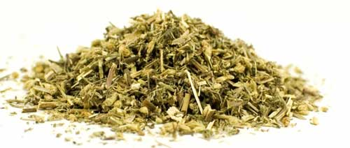
Amowask (Cree) Yarrow
Ingredients:
Flower
Medicinal Properties:
Known for reducing fever and helping relieve symptoms of colds and flu. When used as an ointment it can help with skin rashes and itch.

Slide 22
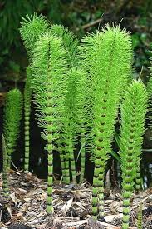
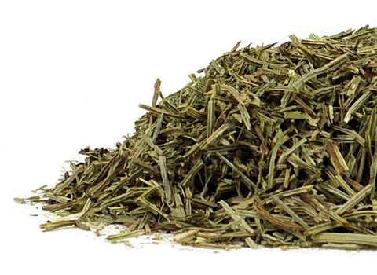
Okacakan-askos (Cree) Horsetail (scouring rush or shavegrass)
Ingredients:
Medicinal Properties:
Used for treating kidney and bladder ailments such as infections or stones. Stems can be ground and used as sandpaper.
*dangerous is large, frequent doses

Slide 23
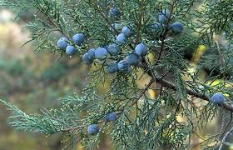
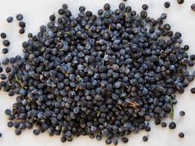
th'eláltel (Halq'eméylem) Juniper Berry
Ingredients:
Berry/fruit
Medicinal Properties:
Beneficial in helping treat high blood pressure, water retention and kidney or bladder infections or stones.

Slide 24
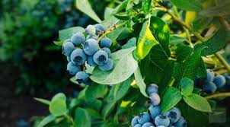
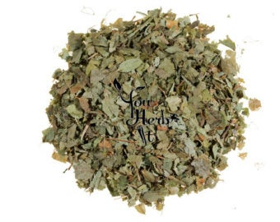
Blueberry Leaf
Ingredients:
Young leaves
Medicinal Properties:
Good for eye health, tiredness and stomach aches caused by gas

Slide 25
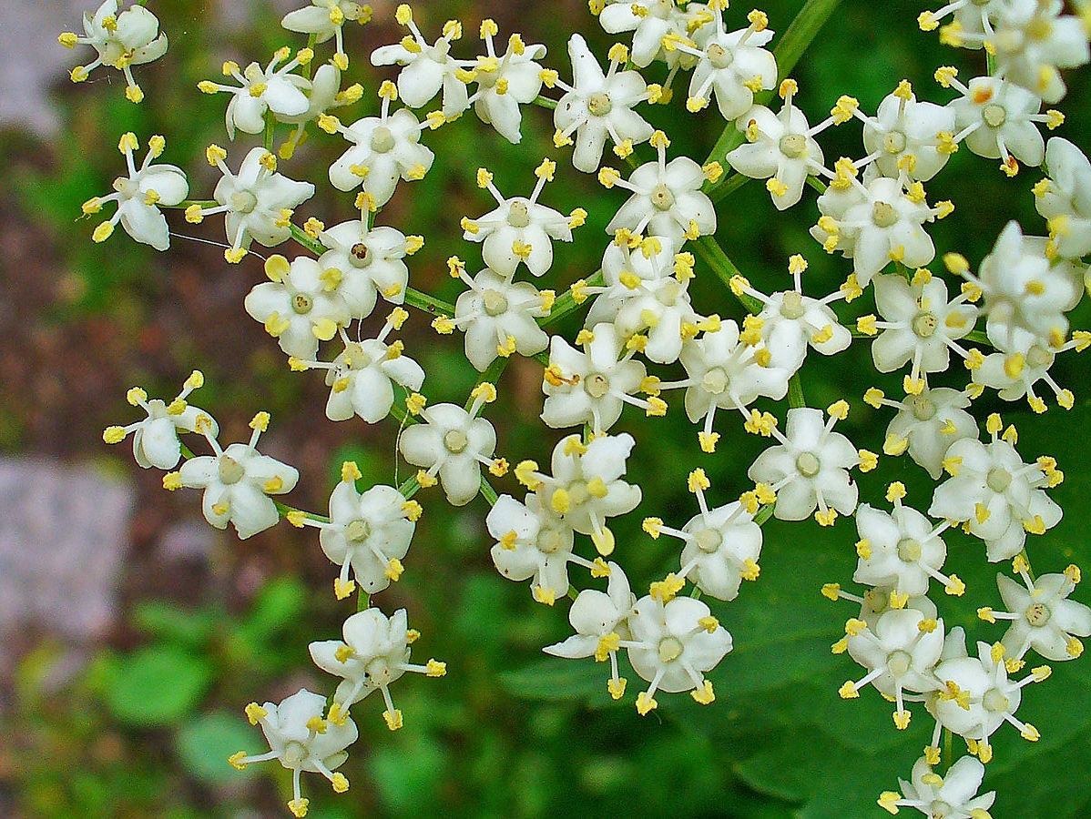
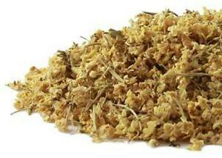
Elder Flower
Ingredients:
flower
Medicinal Properties:
Good for helping reduce the symptoms of colds, flu and sinus infections

Slide 26
Indigenous Name/language: Common Name:
Ingredients:
Medicinal Properties:
Insert dried or prepared plant image

